Slide 1
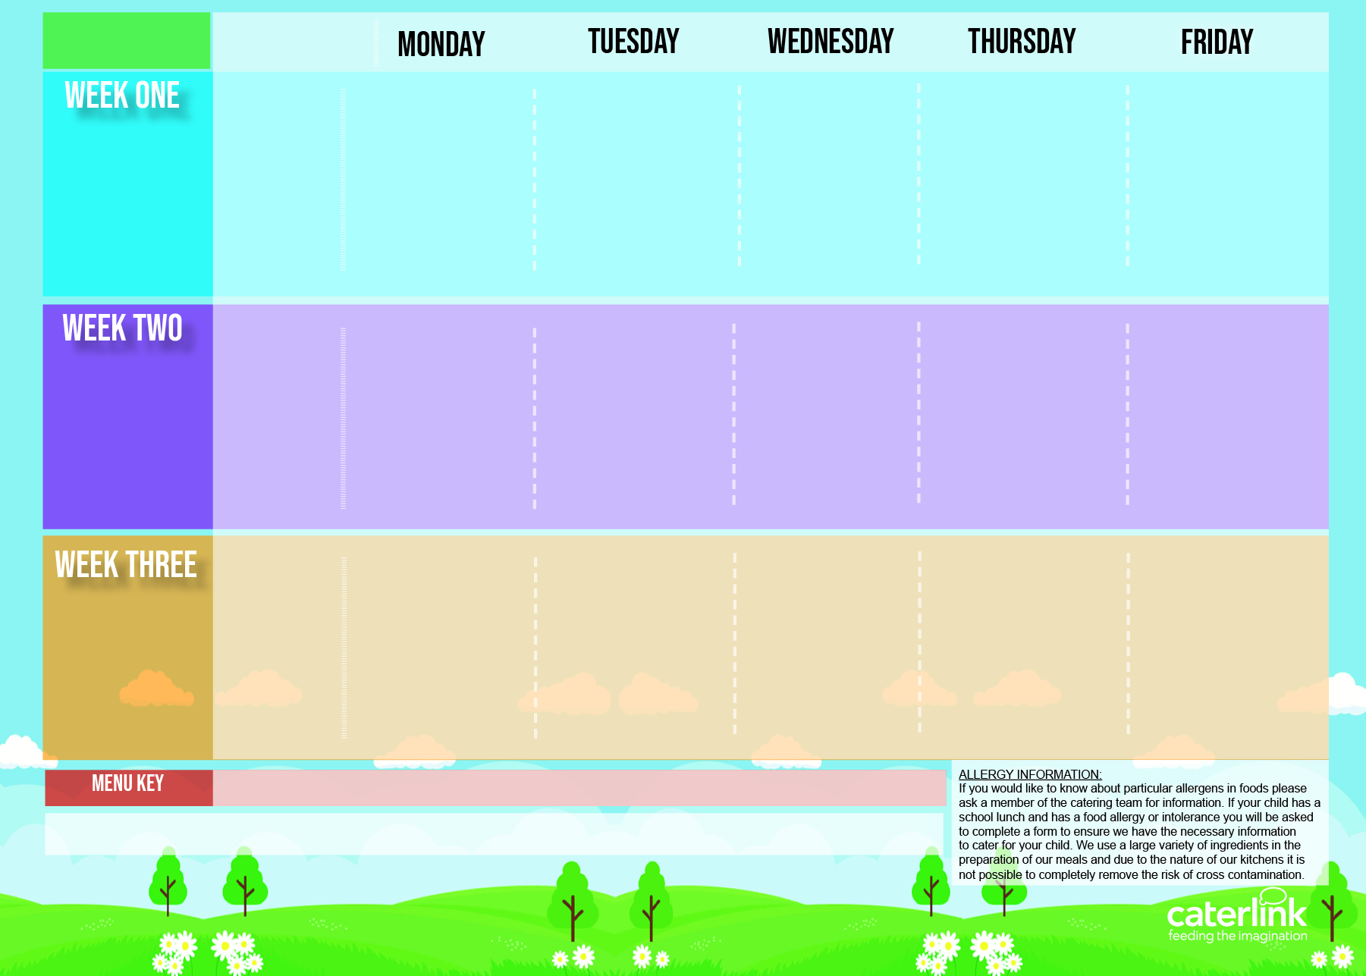





3 Choice Menu
Autumn Winter 2025 2026
Plant Balls in Tomato Sauce with Rice | Beef Lasagne with Garlic Bread | Roast Chicken, Stuffing, Roast Potatoes and Gravy | NEW Chicken Biryani | Fishfingers or Salmon Fishfingers with Chips & Tomato Sauce
Autumn Vegetable Lasagne Jacket Potatoes Cheese Vegetables of the Day | Beetroot and Lentil Burger in a Bun with Potato Wedges Jacket Potatoes Beans Vegetables of the Day | Vegetarian Wellington with Roast Potatoes and Gravy Jacket potatoes Cheese Vegetables of the day | NEW BBQ Vegan Sausage Pasta with Garlic Bread Jacket Potatoes with tuna Vegetables of the day | Cheese and Bean Pasty with Chips and Tomato Sauce Jacket potatoes with Beans Vegetables of the day
Cheese and Crackers | Apple crumb Cake | Fruit Medley | Jelly and Mandarins | Syrup Sponge and custard
Option One
3rd November
24th November
15th December
19th January
9th February
9th March
Option Two
Option Three
Vegetables
Dessert
C cheese and Tomato Pizza with Wedges | Spaghetti Bolognaise | BBQ Chicken BBQ Quorn with Seasoned Potatoes and Sweetcorn Salsa Jacket potatoes Cheese | Beef Meatballs in Tomato Sauce with Rice | Fishfingers with Chips & Tomato Sauce
Mild Mexican Chilli with Rice Jacket Potatoes Cheese Vegetables of the day | Vegan Spaghetti Bolognaise Jacket Potatoes Beans Vegetables of the day |  | Creamy Chickpea and Coconut Curry with Rice Jacket Potatoes with tuna | Cheese Whirl with Chips and Tomato Sauce Jacket potatoes with Beans
 |  | Vegetables of the Day | Vegetables of the Day | Vegetables of the Day
NEW Gingerbread Cookie | Chocolate Brownie with Chocolate Sauce | Fruit Salad | Sticky Toffee Apple Crumble with Custard | Vanilla Shortbread
Option One
10th November
1st December
5th January
26th January
23rd February
16th March
Option Two
Option Three
Vegetables
Dessert
Macaroni Cheese | NEW Chicken Enchilada Bake with Paprika Wedges | Chicken Sausage with Roast Potatoes and Gravy | Mild Caribbean Chicken with Golden Rice Caribbean Stew with Golden Rice Jacket Potato with tuna | Fishfingers with Chips & Tomato Sauce
NEW Chefs Special Lentil Curry with Rice Jacket Potatoes Cheese | All day vegetarian Breakfast Jacket Potatoes Beans | Vegan Sausage and Roast Potatoes and Gravy Jacket potatoes Cheese |  | Red Pepper Frittata with Chips & Tomato Sauce Jacket potatoes with Beans
Vegetables of the Day | Vegetables of the Day | Vegetables of the Day | Vegetables of the Day | Vegetables of the Day
Oaty Cookie | Pear Crumble with Custard | Fruit Salad | NEW Jamaican Ginger Cake with Custard | Cornflake Tart
Option One
17th November
8th December
12th January
2nd February
2nd March
23rd March
Option Two
Option Three
Vegetables
Dessert
Added Plant Protein
Wholemeal
Vegan
Chef’s Special
Available Daily: - Freshly cooked jacket potatoes with a choice of fillings - Bread freshly baked on site daily- Daily salad selection

